Slide 1
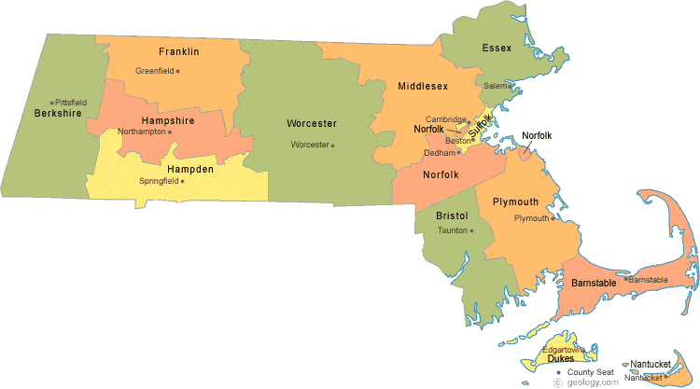
Springfield Area Office 1441 Main Street, Room 550 Springfield, MA 01103-1493 (413)785-0123
Worcester, Franklin, Hampshire, Hampden and Berkshire counties
North Boston Area Office 138 River Road, Suite 102 Andover, MA 01810 (978)837-4460
Middlesex and Essex Counties
Region 1 (Boston) Regional Main Office
JFK Federal Building, 25 New Sudbury Street, Room E340 Boston, MA 02203
(617) 565-9860
South Boston Area Office 639 Granite Street, 4th Floor Braintree, MA 02184 (617)565-6924
Suffolk, Norfolk, Bristol, Plymouth, Barnstable, Dukes and Nantucket counties

